Slide 1


M.Tech Program
Advanced Industry Integrated Programs
Jointly offered by University and LTIMindTree
AI-Powered Flight Delay Predictor & Analyzer
Hetvi Bhora
TID : T8576
Knowledge partner | Implementation partner

Slide 2
Project Title - Calibri body 18
Introduction
Flight delays are a major operational and customer satisfaction issue in the aviation industry.
This project aims to predict average flight delays for specific carriers, airports, and months.
It uses a combination of forecasting algorithms and machine learning models to analyze historical and operational data.
A Large Language Model (LLM) is integrated to generate natural language explanations of the predictions.
Designed to support airlines, airports, and travel platforms in making data-driven decisions.

Slide 3
Project Title - Calibri body 18
Objectives
Data Collection using APIs, Scraping etc..
Predict average flight delay for a given carrier, airport, and month.
Break down delay causes into categories: Carrier, Weather, NAS (National Airspace System), and Late Aircraft.
Generate human-readable explanations using LLMs to support decision-making.
Provide an interactive UI for users to input parameters and view predictions.
Enable future scalability to real-time predictions and broader airport coverage.

Slide 4
Project Title - Calibri body 18
Scope ( Project flow )
Project Setup & Data Collection
Data Cleaning & preprocessing
Exploratory Data Analysis
Forecasting Model Development
Delay Attribution Model
LLM Integration & Explanation Generation
Evaluation & refinement
User Interface
Deployment

Slide 5
Project Title - Calibri body 18
Literature Review
Paper 1: Integrating multiple data sources for improved flight delay prediction using explainable machine learning ( ScienceDirect )
Abstract- The paper proposes a methodology that integrates multiple data sources to improve flight delay prediction using explainable artificial intelligence (xAI). It focuses on identifying key features that influence delays and making the prediction process transparent and interpretable.
Paper 2: Dynamically forecasting airline departure delay probability distributions for individual flights using supervised learning ( ScienceDirect )
Abstract- The paper introduces a dynamic and probabilistic approach to forecasting departure delays for individual flights, using supervised learning. The goal is to improve operational efficiency, especially in hub-and-spoke airlines, by enabling better fuel planning and delay management.

Slide 6
Project Title - Calibri body 18
Industry Resources
FlightAware – Real-time flight tracking and predictive analytics
Airbus Skywise – Aviation data platform with predictive maintenance and delay analytics
GE Aviation – Fuel and delay optimization tools
Cirium – Flight delay prediction and analytics
Lumo – Predictive flight delay alerts for travelers and airlines
FLYR Labs – AI-driven revenue and operations optimization for airlines

Slide 7
Project Title - Calibri body 18
Tech Stack
Steps | Tools/Library/Framework
Data Collection | Python, APIs, BTS, NOAA
Forecasting | Prophet / ARIMA / SARIMAX
Attribution Modelling | Multi-output regression model
LLM Explanation | GPT-4, LangChain ( optional )
Interface | Streamlit / Flask
Deployment | Docker, AWS, GitHub Actions

Slide 8
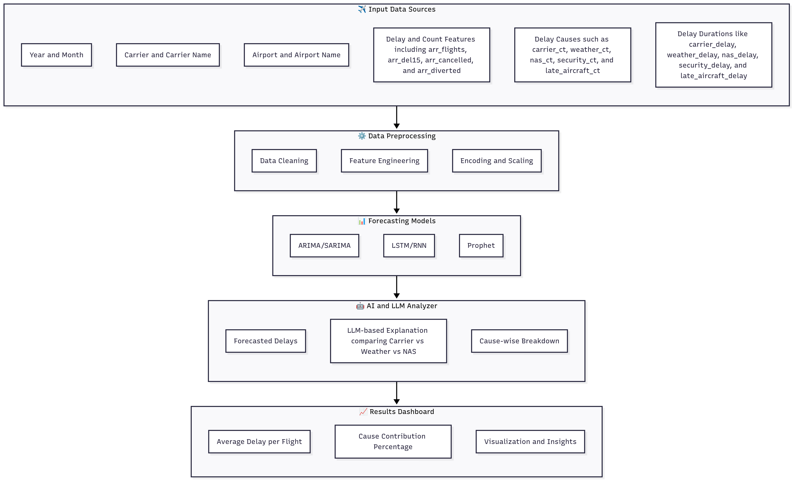
Architecture Diagram : AI-powered Flight Delay Predictor & Analyzer

Slide 9
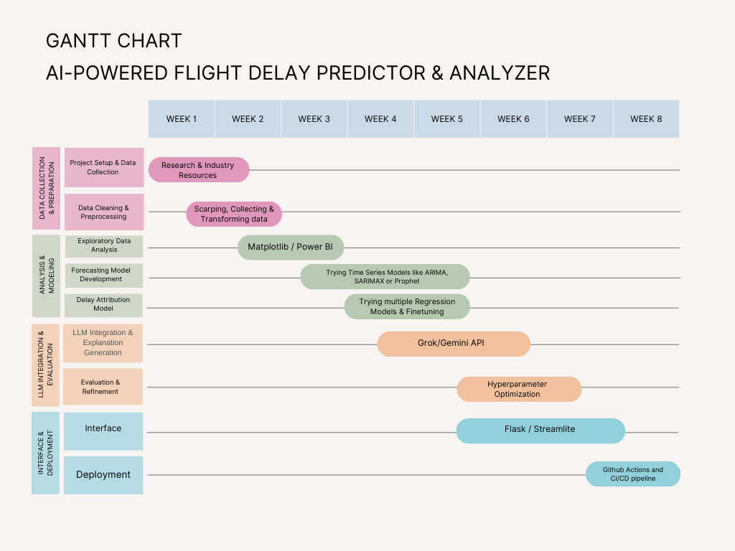
Gantt Chart:

Slide 10
Project Title - Calibri body 18
Step 1: Project setup & Data Collection
Project setup is done in Vscode.
Data Collection is done from the website named “Bureau of Transportation & Statistics” ( BTS ) which contains data of United States Department of Transportation.
It contained many columns like year, month, carrier, carrier_name, airport, airport_name, arr_flights, carrier_ct, weather_ct, nas_ct, security_ct, late_aircraft_ct, arr_diverted, arr_delay carrier_delay weather_delay nas_delay security_delay late_aircraft_delay and many more.

Slide 11
Project Title - Calibri body 18
Step 2: Data Cleaning & Preprocessing
After the data is collected, we proceed with data cleaning where:
Some null values are dropped and duplicates are removed
Created a proper datetime column for grouping
Renamed the columns according to the usage
Feature selection to retain only relevant features

Slide 12
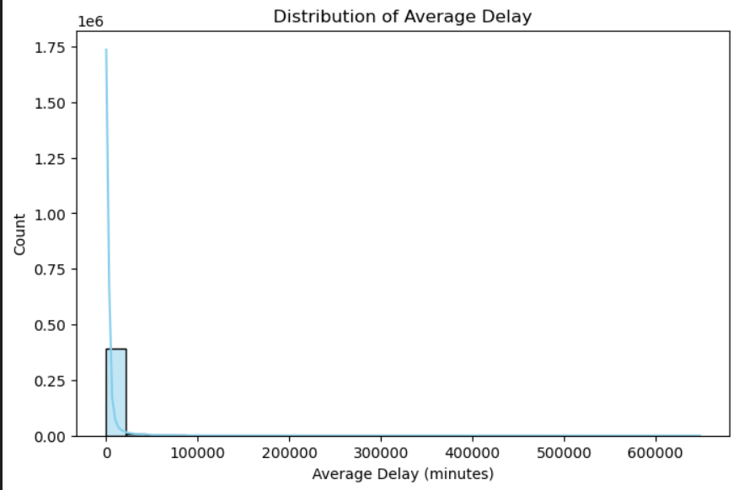
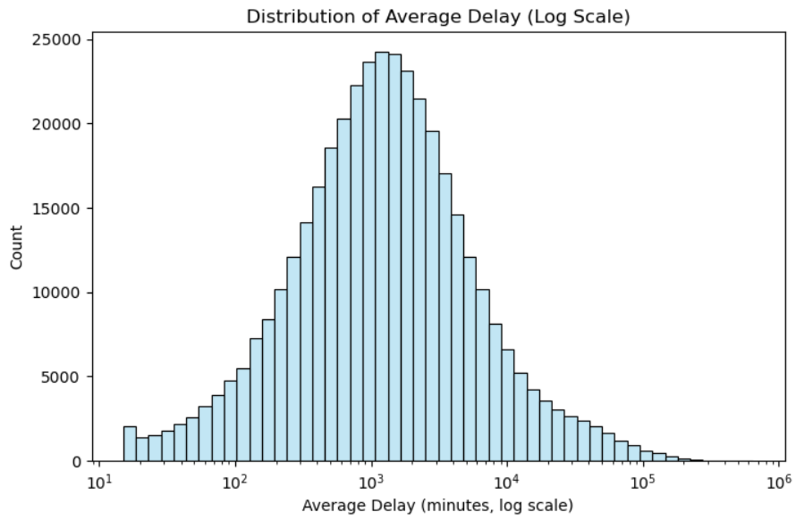
Project Title - Calibri body 18
Step 2: Exploratory Data Analysis
The distribution of average delays is highly right-skewed with extreme outliers inflating the scale. After applying a log transformation, the data reveals a more normal-like pattern, showing that most flights face moderate delays while a few experience very large disruptions.

Slide 13
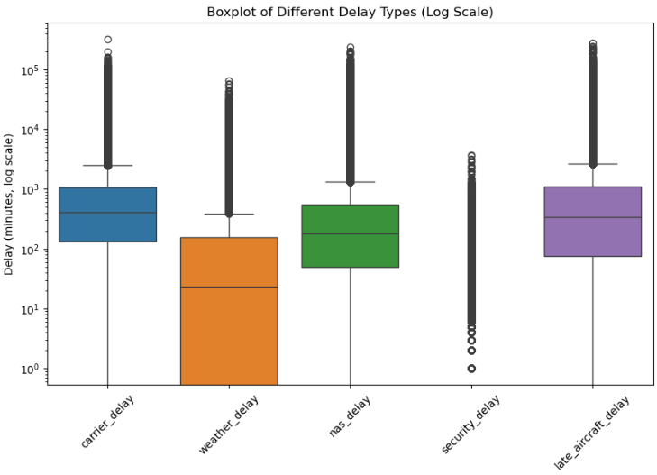
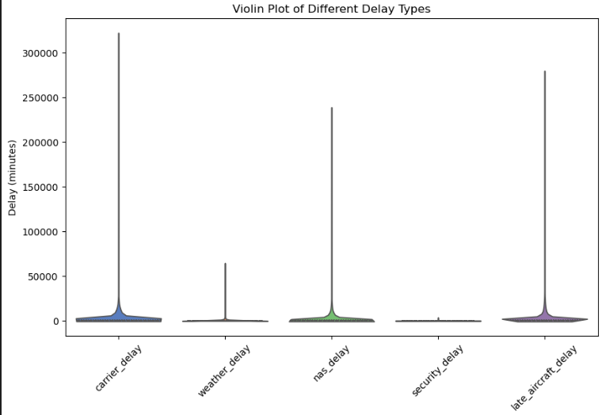
Project Title - Calibri body 18
Step 2: Exploratory Data Analysis
On a log scale, late aircraft and carrier delays show higher median and wider spread, while weather and security delays remain relatively lower. This highlights late aircraft as a major contributor to variability.
Carrier and late aircraft delays dominate with broader distributions, whereas weather and security delays are concentrated at lower values. This confirms operational and aircraft issues as primary drivers of delay.

Slide 14
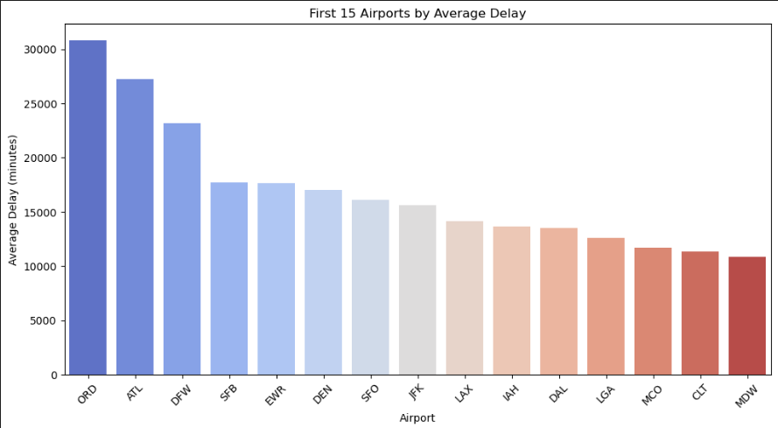
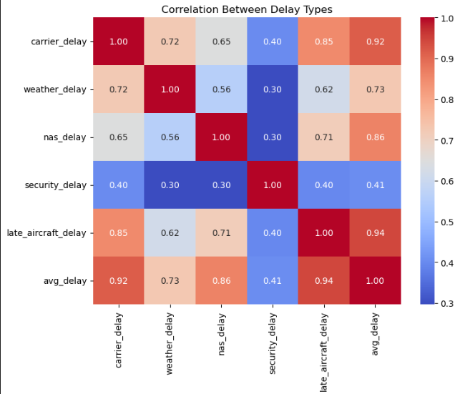
Project Title - Calibri body 18
Step 2: Exploratory Data Analysis
This chart shows that ORD (Chicago O’Hare) and ATL (Atlanta) have the highest average delays among the top 15 airports, while MDW (Chicago Midway) and CLT (Charlotte) experience the lowest delays in this group.
The heatmap shows that late aircraft delays and carrier delays are most strongly correlated with overall average delays, while security delays have the weakest correlation with other delay types.

Slide 15
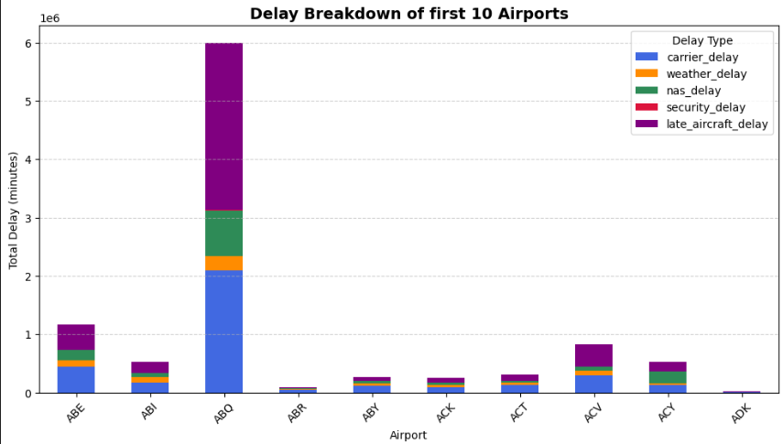
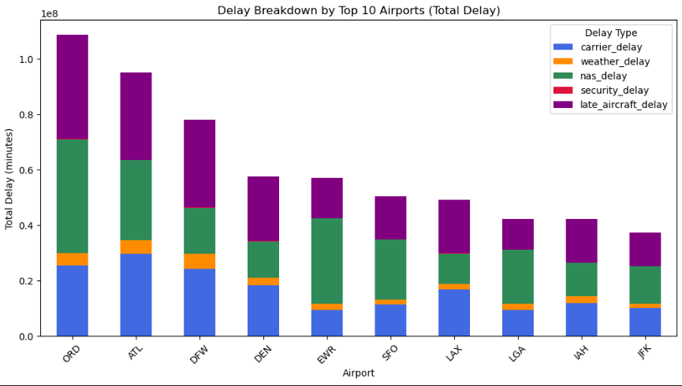
Project Title - Calibri body 18
Step 2: Exploratory Data Analysis
Most of these smaller/regional airports show relatively low total delays, except ABQ (Albuquerque) which stands out with a much higher delay volume. Again, carrier delays (blue) and late aircraft delays (purple) dominate for ABQ, while others remain at smaller scales.
ORD (Chicago O’Hare) and ATL (Atlanta) lead with the highest total delays, exceeding other airports significantly. Across these top airports, carrier delays (blue), NAS delays (green), and late aircraft delays (purple) are the largest contributors to total delay. Weather delays (orange) and security delays (red) are relatively minor in comparison.

Slide 16
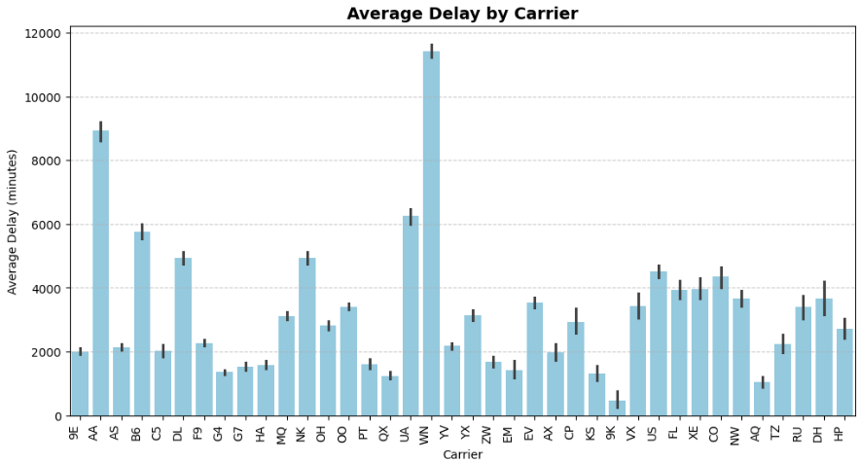
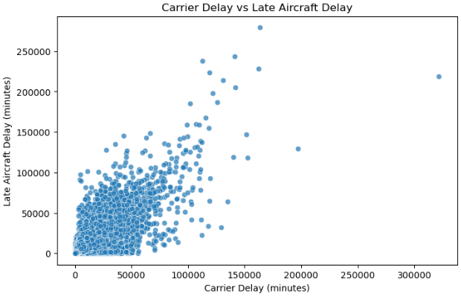
Project Title - Calibri body 18
Step 2: Exploratory Data Analysis
Average Delay by Carrier (Bar Plot): A few carriers, especially AA and WN, show significantly higher average delays compared to others, indicating performance issues concentrated in specific airlines.
Carrier Delay vs Late Aircraft Delay (Scatter Plot): There’s a positive correlation — higher carrier delays are often linked with higher late aircraft delays, suggesting cascading effects of initial delays.

Slide 17
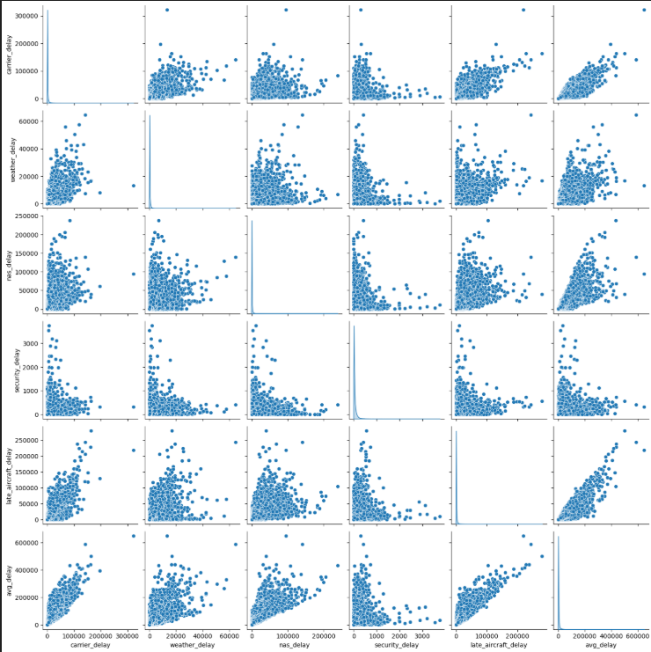
Project Title - Calibri body 18
Step 2: Exploratory Data Analysis
This pairplot shows that carrier_delay, nas_delay, and late_aircraft_delay are strongly correlated with overall average delay, indicating they are the main contributors. In contrast, weather_delay and security_delay show weaker relationships, meaning they have less overall impact on total delays.

Slide 18
Thank You

